Slide 1

ZBA Presentation
August 5^{th,} 2021

Slide 3
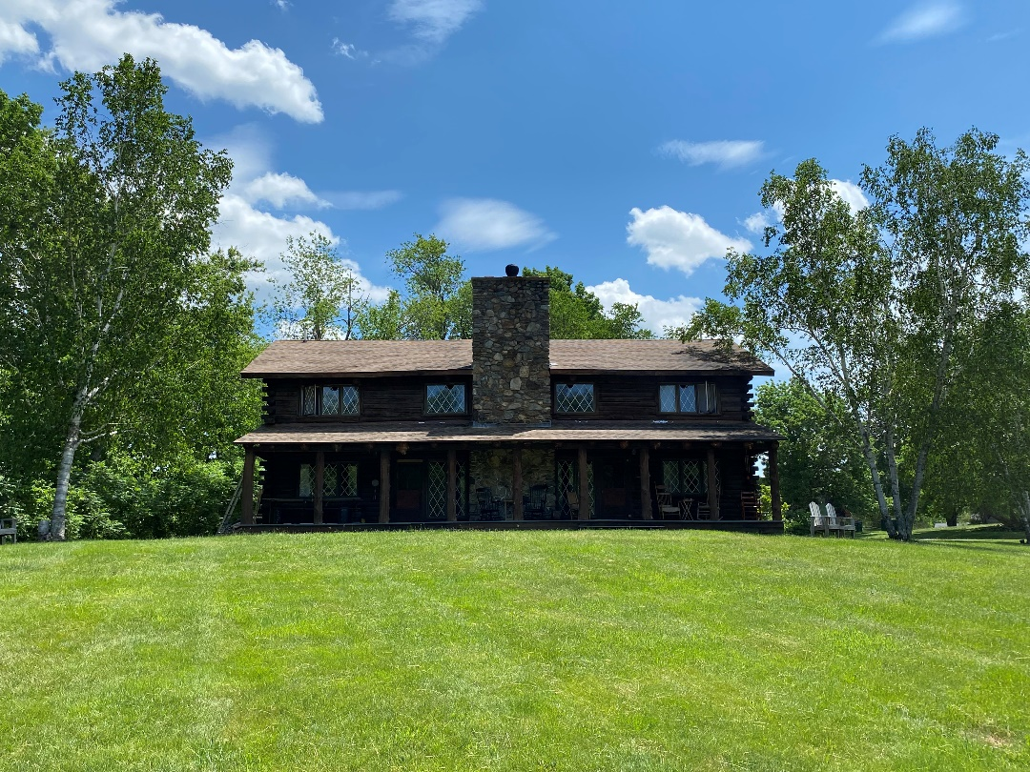
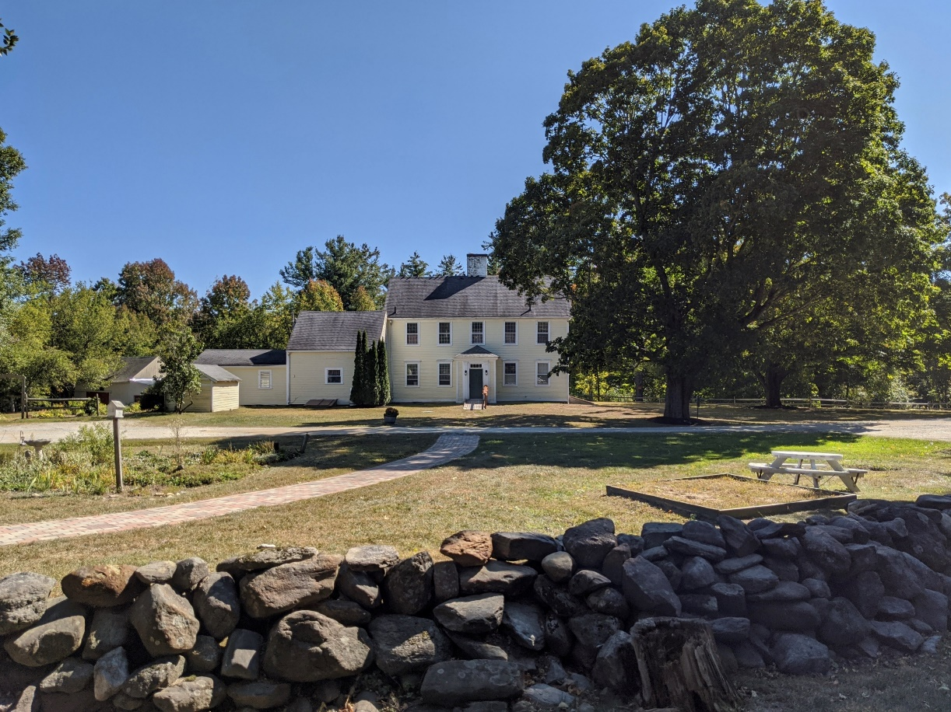
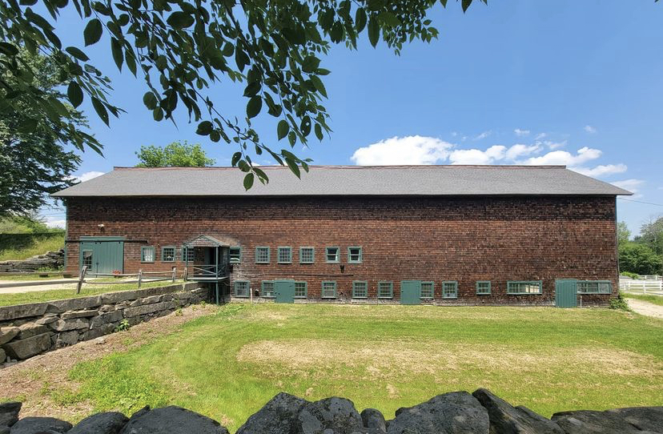
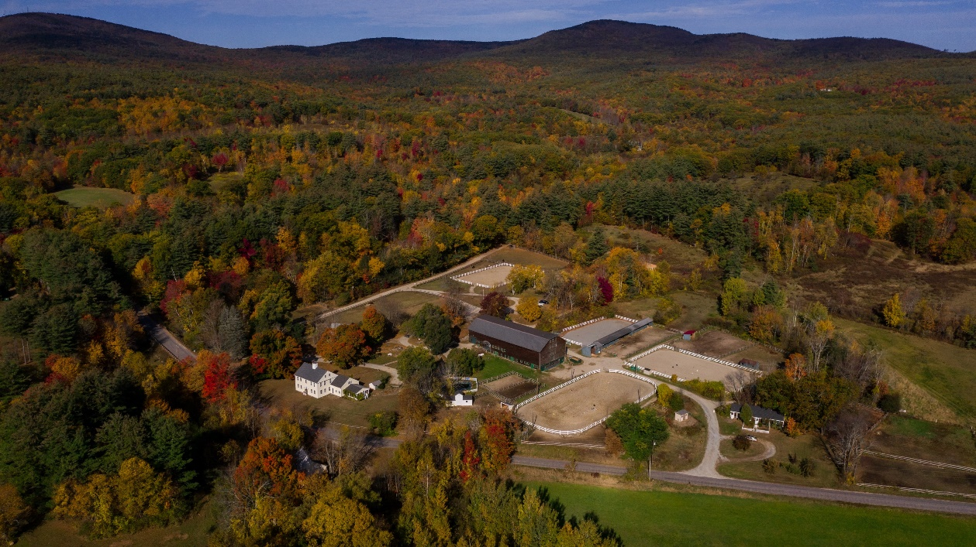

Slide 4
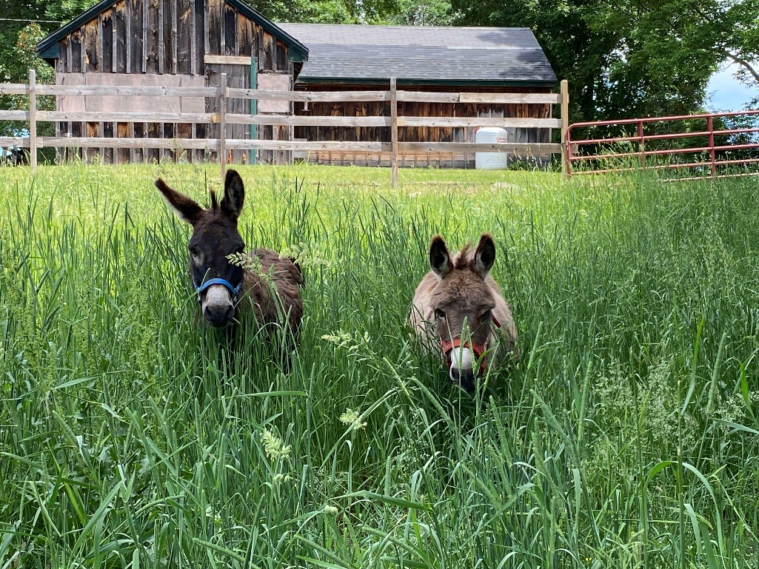
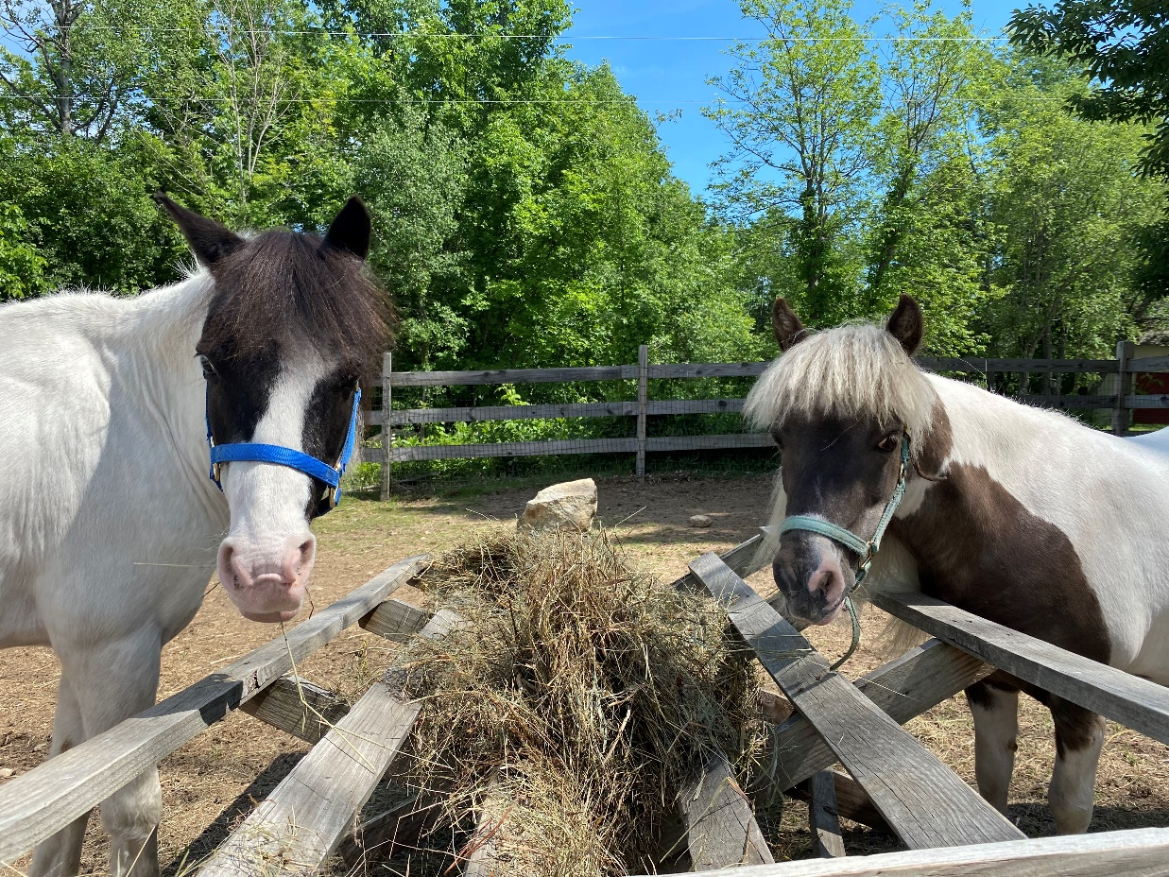
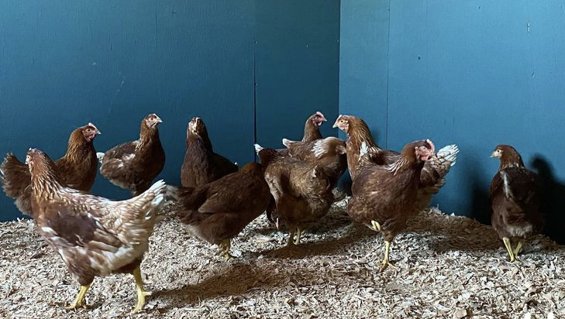
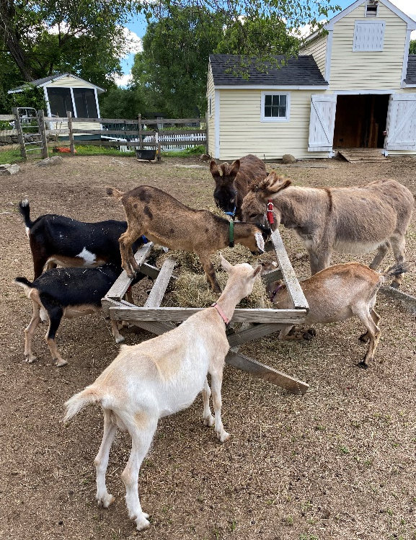

Slide 6
Fire Access
Parking Areas
Emergency Gathering Areas

Slide 7
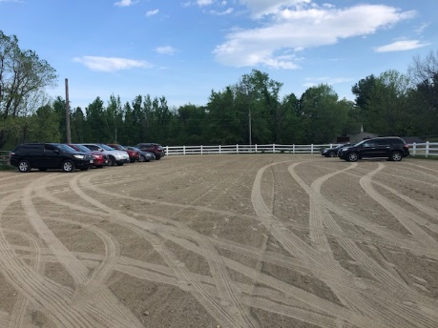
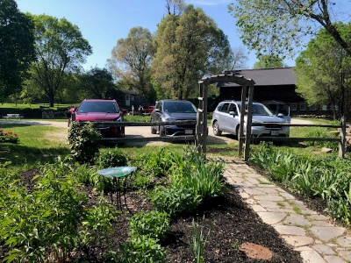
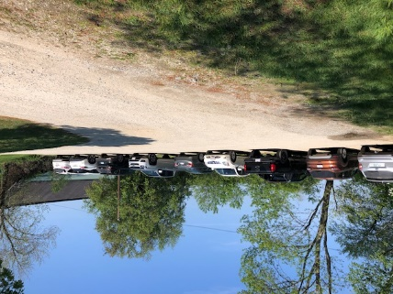
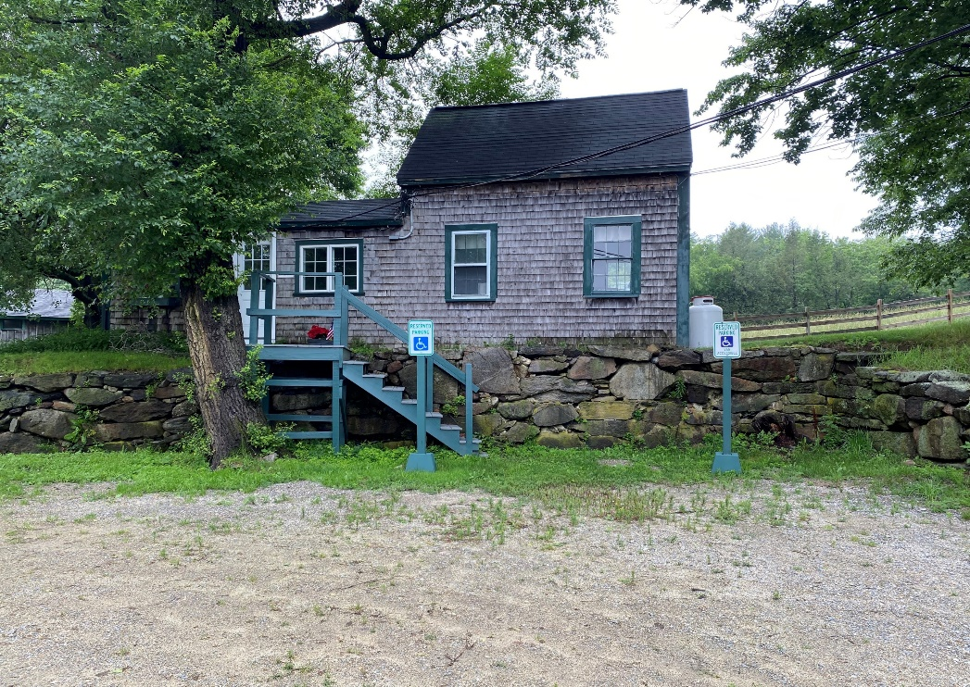

Slide 8
No adverse affects on adjacent properties.
Recent transactions directly across Webster Highway in Stonegate Farm, where prospective buyers would have seen our event center signage:
5 acres sold on April 30th for $130,000
5 acres sold on March 3rd for $160,000
5 acres sold on March 8th for $160,000
2 bedroom 3,700 sqft home sold on May 13, 2021 for $750,000
3 bedroom 3 bathroom 2,797 sqft sold on September 30, 2020 for $540,000
Recent transactions in greater Temple:
11 acres sold on March 5th for $140,000
5 bedroom 4 bath 3,496 sqft home sold on April 12, 2021 for $442,000
4 bedroom 3 bath 4,064 sqft home sold on April 29th for $330,000

Slide 9
Reuter Associates
Mr. Reuter is an expert in assessment, modeling, and mitigation of environmental noise. He has managed several hundred environmental noise projects in areas such as transportation, industrial processes, manufacturing, mineral extraction, telecommunications, recreational facilities, and protection of conservation land.
To meet the 35-dBA nighttime limit at the Webster Rd. location described above, the sound level (L10) incident upon the inside of the exterior wall of the barn should be limited to 80 dBA for typical pop/dance music. This is a reasonable limit for the type of events proposed.
This limit may be enforced through either electronic limiting of the sound system, or by directly monitoring sound levels within the barn. Both approaches are practical,
common, and easily implemented.
Professional Affiliations
Acoustical Society of America – Fellow
Institute of Noise Control Engineering – Board Certified Member
National Council of Acoustical Consultants – President
Using measurements of the noise reduction between the interior of the barn and known distances outdoors, noise reduction between the interior of the barn and several off-site locations were calculated. These locations, shown on Figure 1, represent the property lines of the nearest parcels in each direction.
Based on these calculated values, a typical pop/dance music spectrum was used to determine a maximum interior sound level that would meet the nighttime limit of 35 dBA at all locations. The location most impacted is the nearest adjacent property, which begins at the far edge of Webster Rd., approximately 220 ft to the southeast of the barn. Levels at any other off-site location will be lower than those at this point.
Of special concern is the property line to the east, as it is also the Temple/Wilton town line. Levels here are expected to be at least 15 dBA lower than the limit.

Slide 10
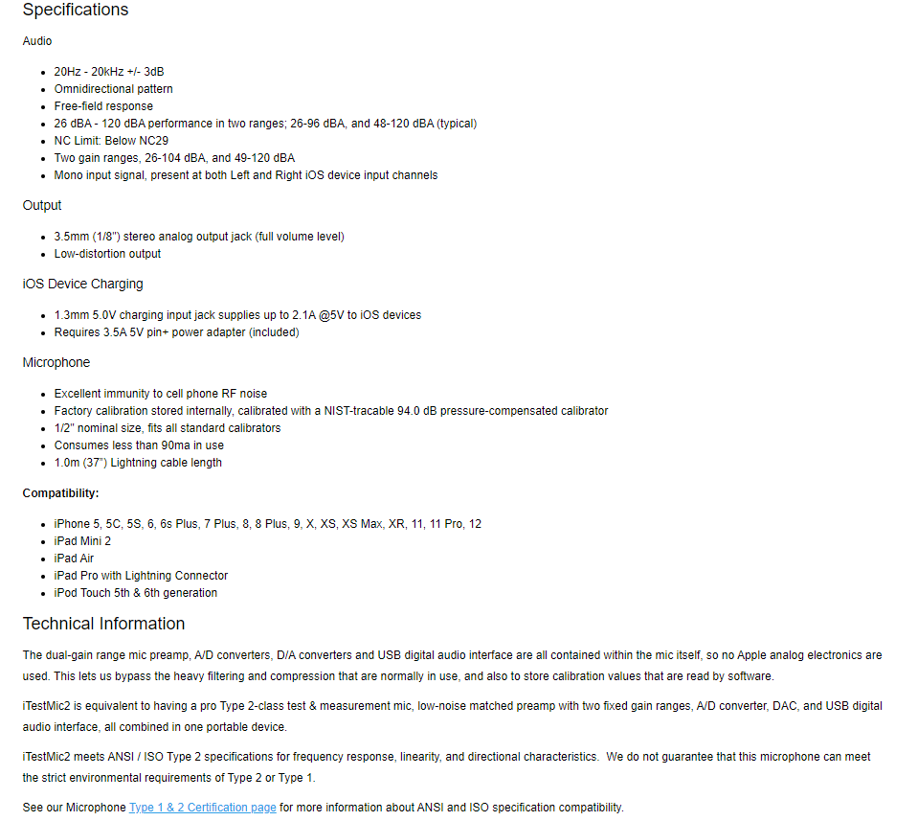
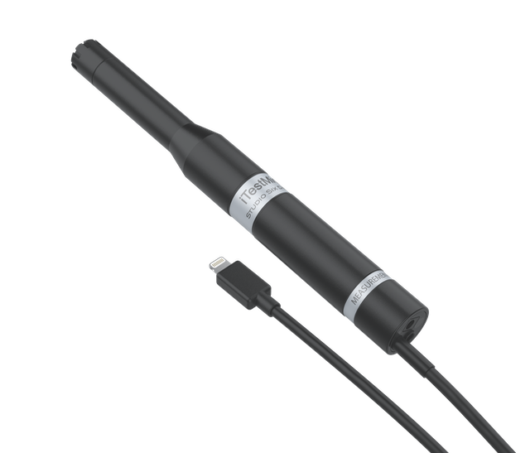

Slide 11
Noise Prevention
Step 1: Prospective Client tour, noise rules conveyed
Step 2: Contract with security deposit for noise violations
Step 3: Noise rules and penalties agreed to by all DJs
Step 3: Establish responsible Point of Contact prior to arrival.
Step 4: Welcome packet reiterating noise rules in writing
Step 5: Guest greeting with verbal overview of noise rules
Step 6: Quiet Enjoyment Protocol posted in bedrooms and kitchen
Step 7: Onsite, live-in Security Person to monitor noise at all times

Slide 12
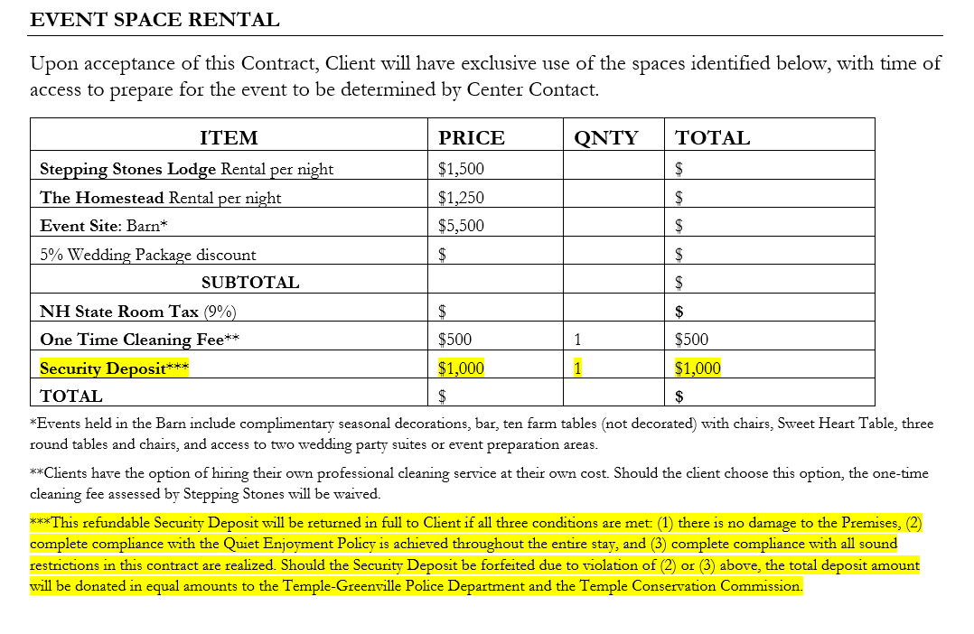
Enforcement
Three strikes and you’re out!
Strike 1: Onsite Staff member calls point of contact to state that noise is above the town ordinance.
Strike 2: Onsite Staff member or owner goes to speak to the point of contact and requests that the group go indoors.
Strike 3: Owner calls the Temple Police and $1,000 security noise deposit is forfeited and proceeds donated to the Temple Police Department and Temple Historical Society.

Slide 13
Touchstone Farm Traffic
Stepping Stones Farm and Event Center Traffic
Lessons @ 100 per week + 50 volunteers + 18 instructors and staff (40 weeks) = 6,740 trips
Weekend Events @ 2 per month for 9 months: average of 20 people, 2 staff= 396 trips
Horse Shows @ 6 per year: average 75 riders, 40 trailers, 10 horse vans, 1 car per rider= 750 trips
Summer Camp @ 6 sessions: i) average 36 campers, 10 CITs (2x/session), ii) 20 staff (7x/session)=
i) 552 + ii) 840 = 1,392 trips
Hay Truck @ 1 per month with 18 tons of hay for 12 months = 24 trips
Manure Dumpster @ 1 per day for 3 summer months = 90 trips
Manure Dumpster @ 2 per week for 9 months= 160 trips
Total= 9,552
Assuming the very highest theoretical utilization (i.e. not what we are seeking a special exception for):
99 guests per weekend, with 20 staff, 52 weeks per year:
Total= 6,188
Reduction of trips: 3,364 or 35%
Assuming much more likely numbers in line with the special exception we are seeking:
Avg 75 guests per weekend, 20 weekends per year with 10 staff = 1,700 trips
25 guests per week, 12 staff visits per week, and 5 utility/maintenance visits per week the remaining 32 weeks of the year = 1, 344
Total= 3,044
Reduction of trips: 6,508 or 68%

Slide 14
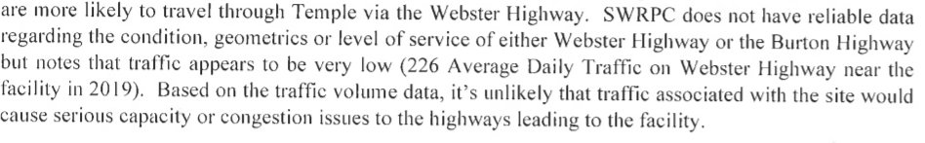
Safety on Roads
Since 2005, Webster Highway has seen the following accidents
  June 2008 and June 2011: avoided Deer
  March 2011, December 2017 and January 2018: went off road due to icy conditions
Excerpted from Southwest Region Planning Commission letter dated June 9th, 2021 page 3

Slide 15


Light and Glare
Outdoor lights on the farm have been professionally replaced with Dark Sky compliant lights. Examples:

Slide 16
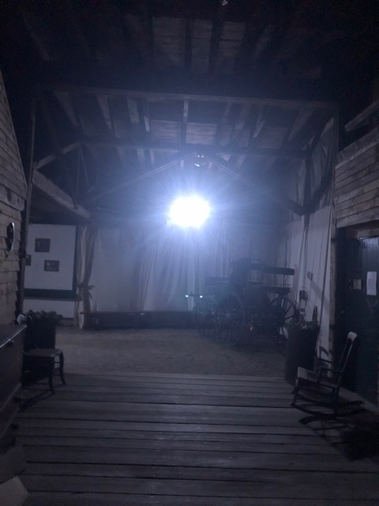
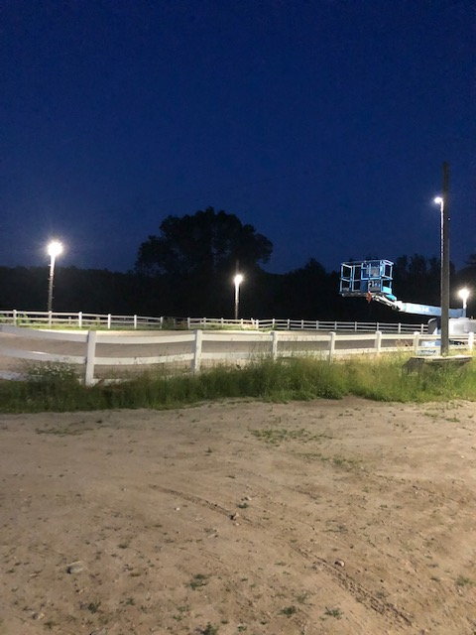
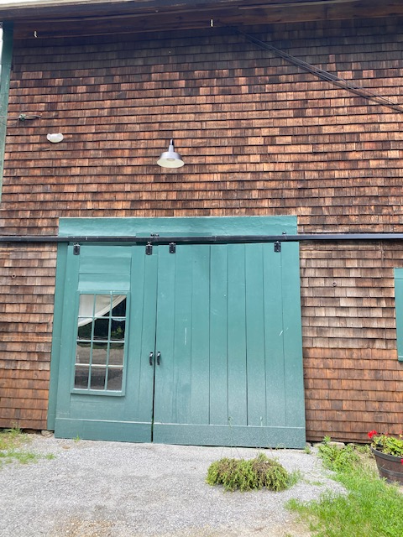

Slide 17
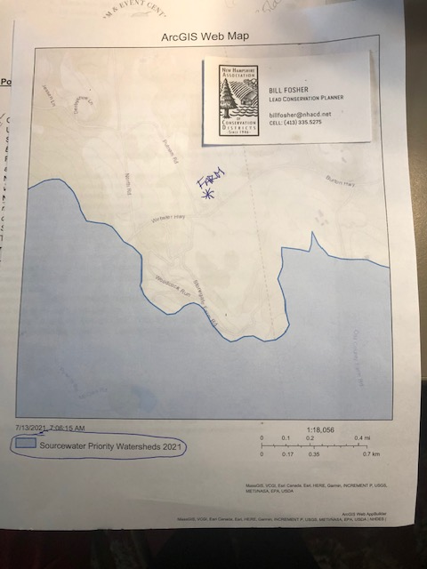
Drainage & Water Quality
Bill Fosher, the Lead Conservation Planner with the New Hampshire Association of Conservation Districts, assisted in obtaining this map of Priority Watersheds. Our farm does not lie within the boundaries of such a watershed.
Additionally, the farm will have less vehicular traffic, less animal waste, and fewer trucks, tractors, and unregulated off-highway equipment.
With a drastic reduction in the number of horses and a return to sustainable grazing, the farm will have less soil erosion and runoff of animal waste.

Slide 18
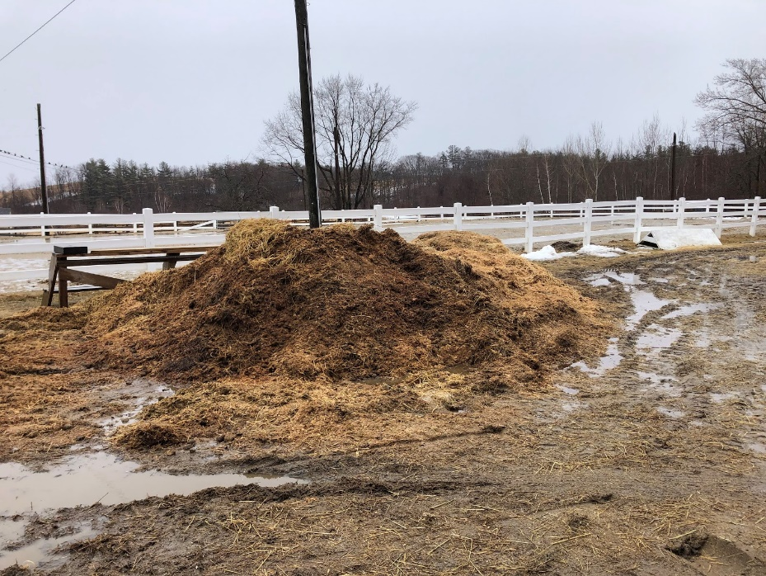
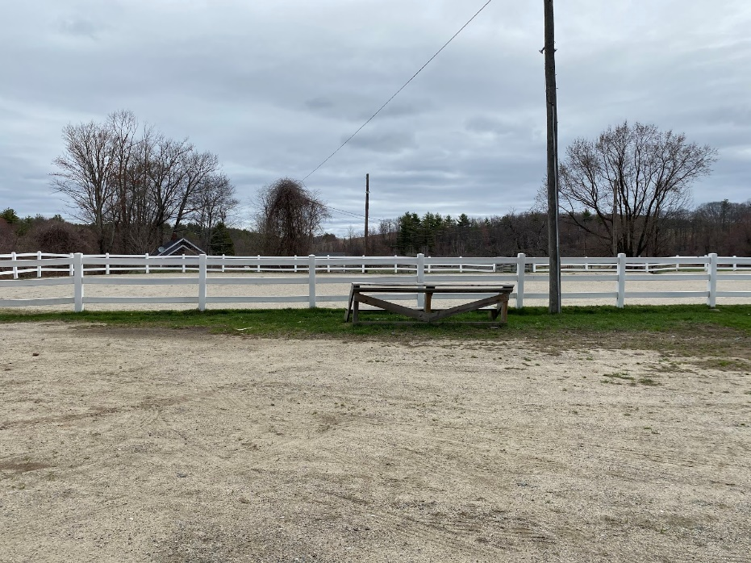
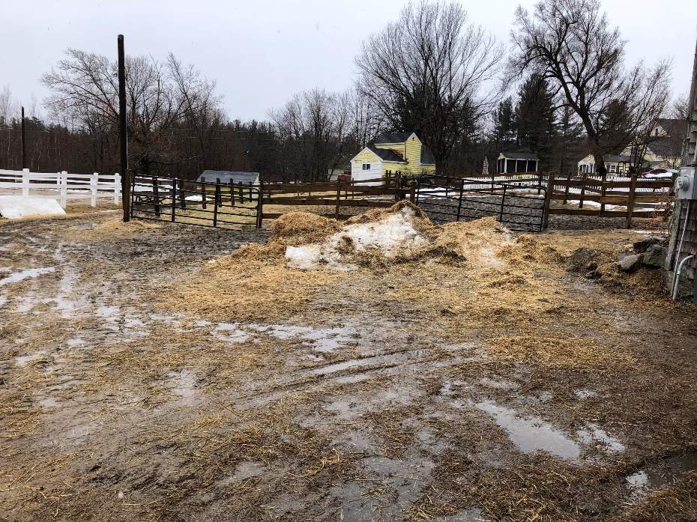
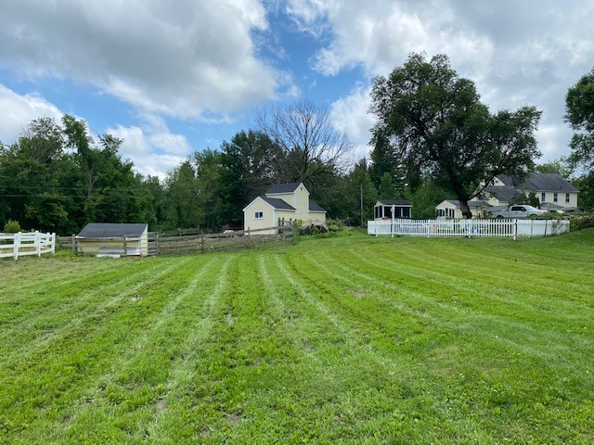
Touchstone Farm 2020
Stepping Stones Farm 2021
BEFORE
AFTER
BEFORE
AFTER

Slide 19
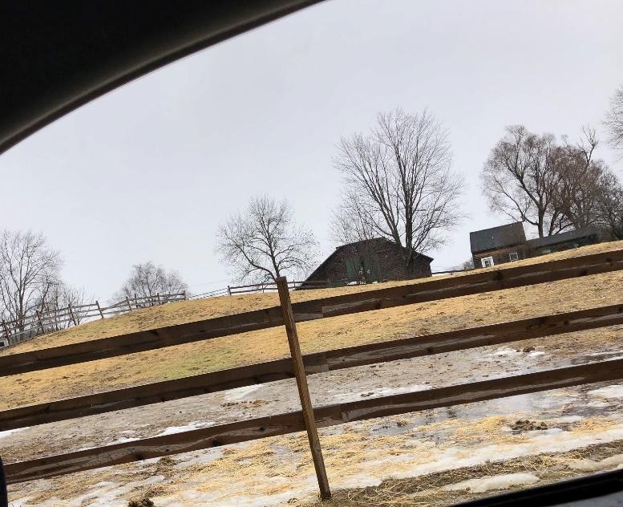
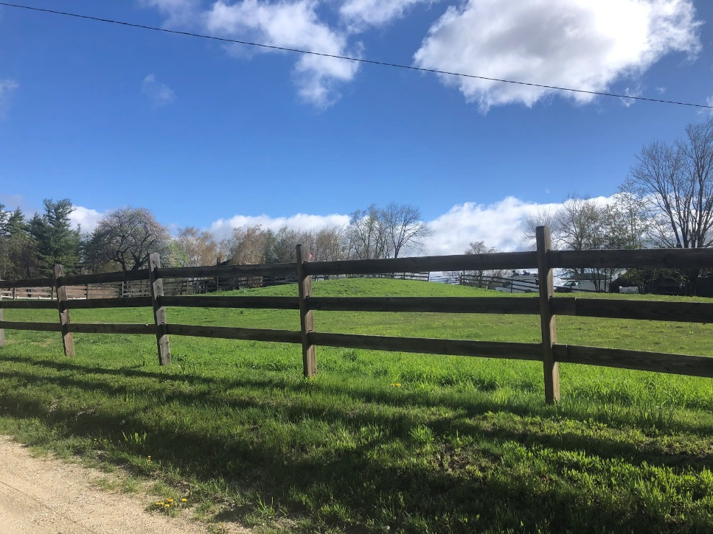
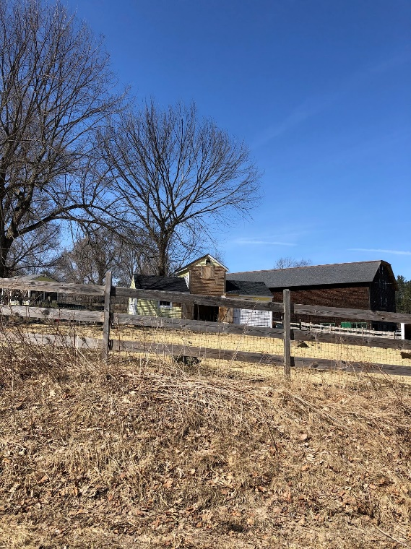
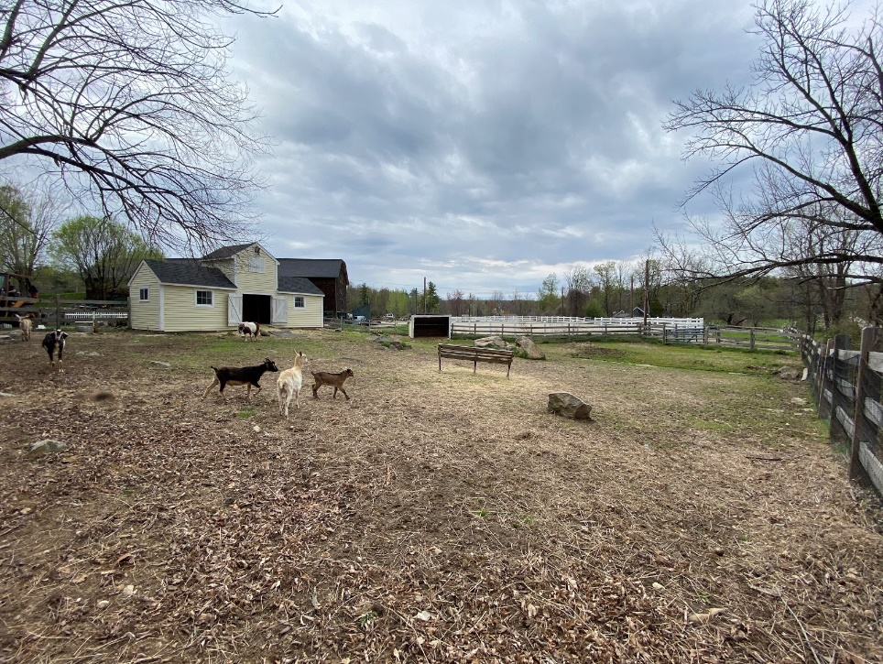
Touchstone Farm 2020
Stepping Stones Farm 2021

Slide 20
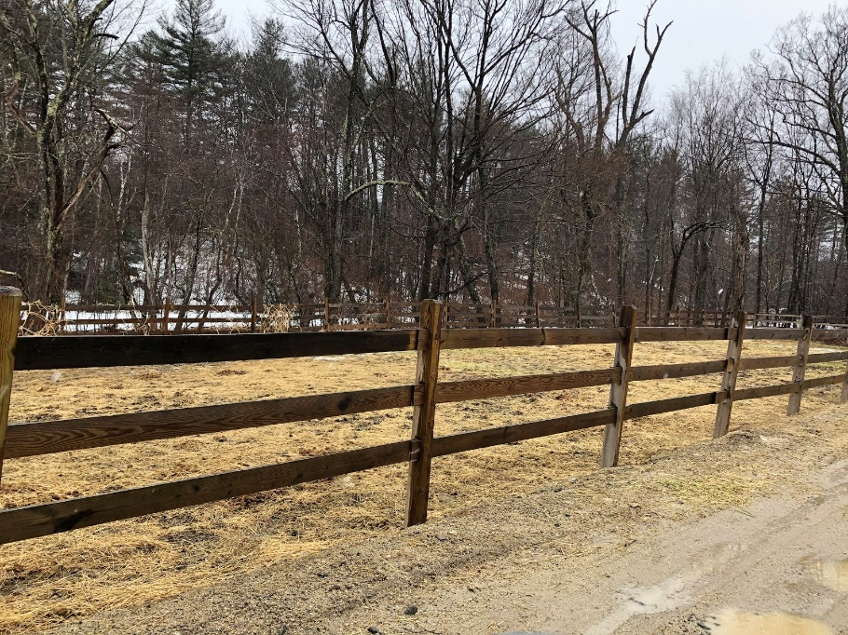
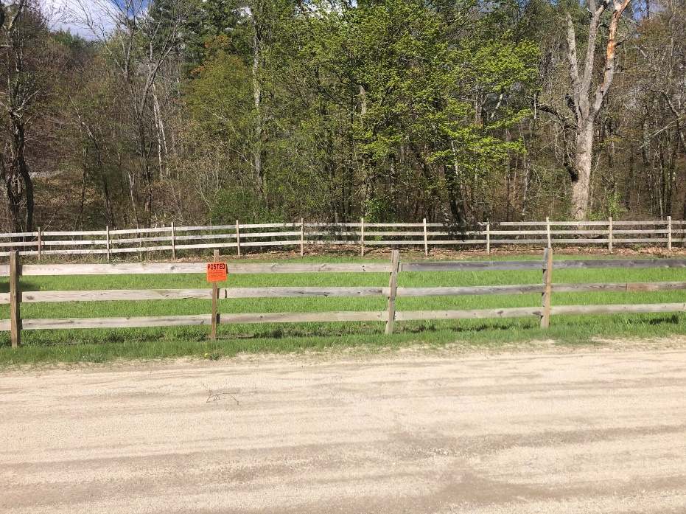
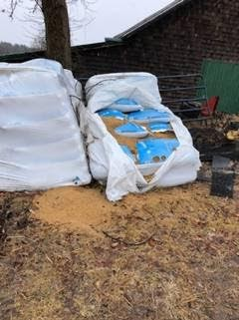
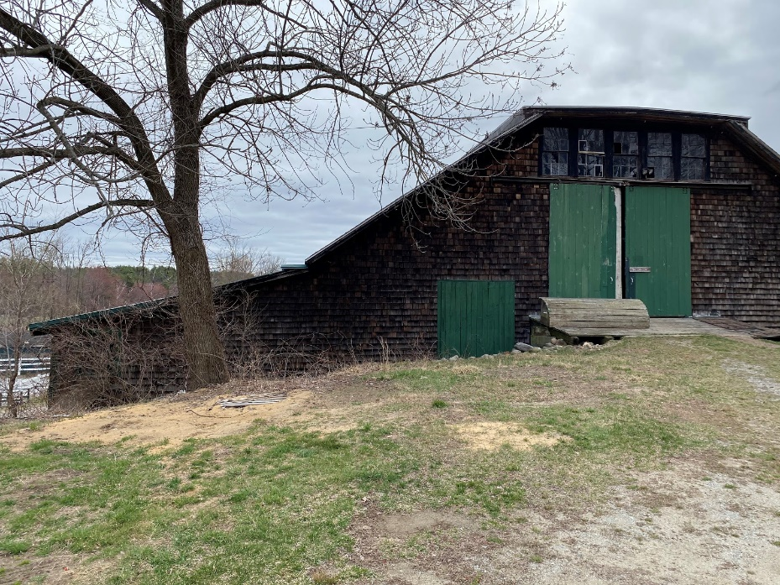
Touchstone Farm 2020
Stepping Stones Farm 2021

Slide 21
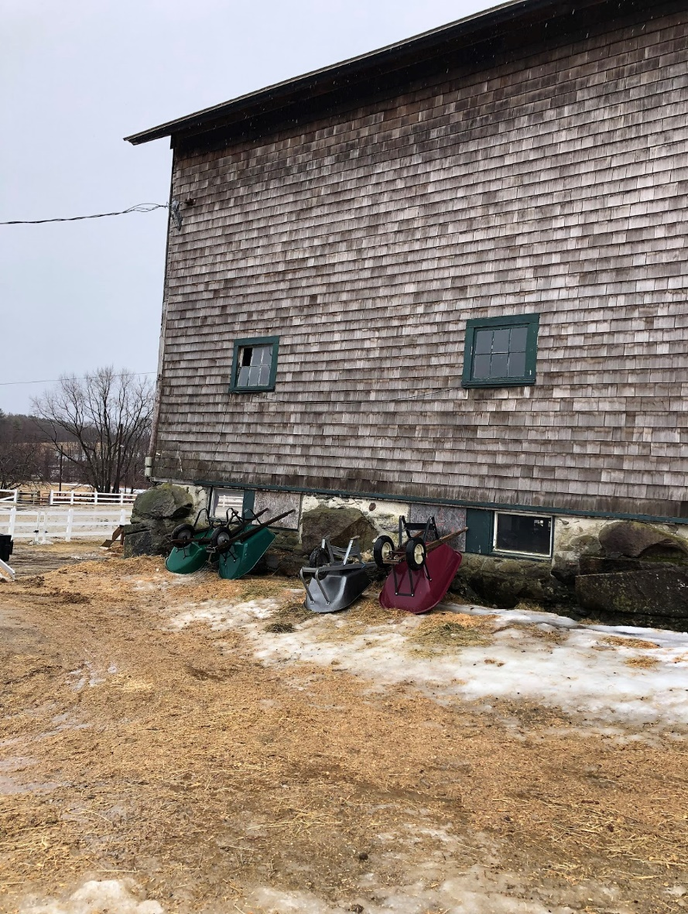
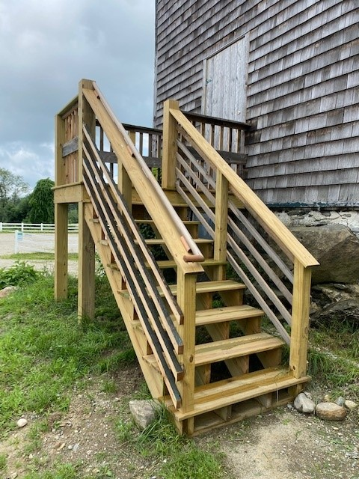
Touchstone Farm 2020
Stepping Stones Farm 2021
Before
After

Slide 22
Thank you

